Slide 1
OOPS in JAVA
Name- Janmejay Kumar Singh
Email – janmejaysinghbhumi000@gmail.com
Mobile No. 8405008738

Slide 2
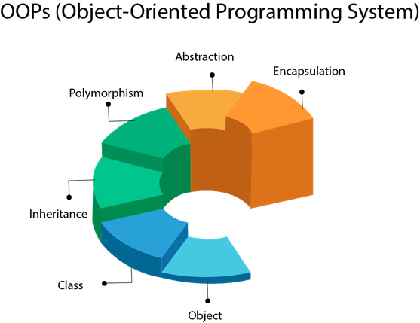
Object oriented programming in java OBJECT ORIENTED PROGRAMMING IN JAVA
OOPs refers to languages that use objects in programming, they use objects as a primary source to implement what is to happen in the code.
Object-oriented programming aims to implement real-world entities like inheritance, hiding, polymorphism etc. in programming.
The main aim of OOP is to bind together the data and the functions that operate on them so that no other part of the code can access this data except that function.
It simplifies the software development and maintenance by providing some concepts: Class, Object, Inheritance, Polymorphism, Abstraction, Encapsulation

Slide 3
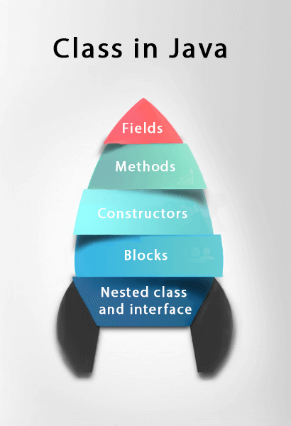
CLASS
A class in Java is a set of objects which shares common characteristics/ behaviour and common properties/ attributes.
It is a user-defined blueprint or prototype from which objects are created.
For example, Student is a class while a particular student named Ravi is an object.
Properties of Java Classes
Class is not a real-world entity. It is just a template or blueprint or prototype from which objects are created.
Class does not occupy memory.
Class is a group of variables of different data types and a group of methods.
A Class in Java can contain: Fields, Methods, Constructors, Blocks, Nested Class and Interface

Slide 4
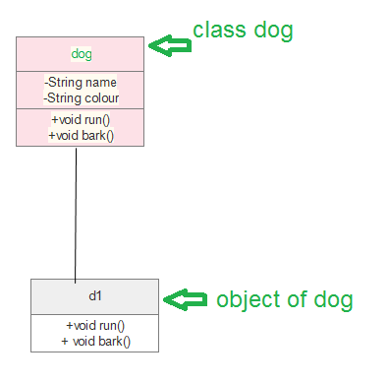
OBJECTS
An object in Java is a basic unit of OOPS and represents real-life entities
Objects are the instances of a class that are created to use the attributes and methods of a class.
An object consists of :
State: It is represented by attributes of an object. It also reflects the properties of an object.
Behaviour: It is represented by the methods of an object. It also reflects the response of an object with other objects.
Identity: It gives a unique name to an object and enables one object to interact with other objects.
To Create an Object of a Class use:
Using new keyword
Using Class.forName(String className) method
Using clone() method
Deserialization
Example of an object: Dog

Slide 5
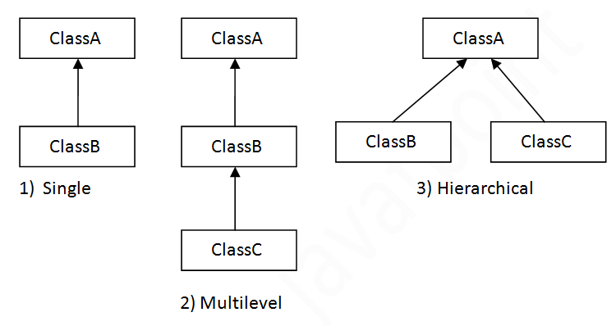
INHERITANCE
Java, Inheritance is an important pillar of OOP.
It is the mechanism in Java by which one class is allowed to inherit the features(fields and methods) of another class.
In Java, Inheritance means creating new classes based on existing ones. A class that inherits from another class can reuse the methods and fields of that class. In addition, we can add new fields and methods to your current class as well.
Why Do We Need Java Inheritance?
Code Reusablility, Method Overriding, Abstraction
Important Terminologies Used in Java Inheritance
Class, Super Class/Parent Class, Sub Class/Child Class, Reusability
How to Use Inheritance in Java? Syntax:
Types of Inheritance
class derived-class extends base-class { //methods and fields }

Slide 6
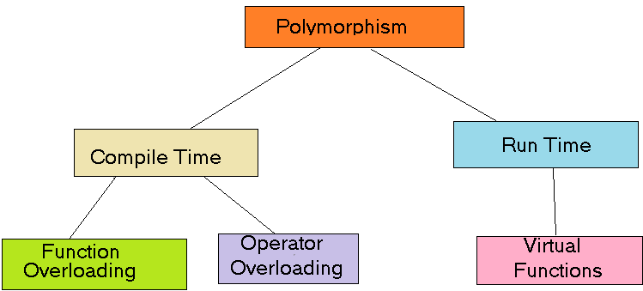
POLYMORPHISM
Polymorphism is considered one of the important features of OOPs.
Polymorphism allows us to perform a single action in different ways also allows to define one interface and have multiple implementations.
The word “poly” means many and “morphs” means forms, So it means many forms.
Advantages of Polymorphism in Java
Increases code
Improves readability and maintainability of code
Supports dynamic binding, enabling the correct method to be called at runtime
Enables objects to be treated as a single type.
Disadvantages of Polymorphism in Java
Can make it more difficult to understand the behaviour of an object, especially if the code is complex.
This may lead to performance issues, as polymorphic behaviour may require additional computations at runtime.
Types of Java polymorphism

Slide 7
ABSTRACTION
In Java, Data Abstraction is the property by virtue of which only the essential details are displayed to the user. The trivial or the non-essential units are not displayed to the user.
Java Abstract classes
An abstract class is a class that is declared with an abstract keyword.
An abstract class may or may not have all abstract methods. Some of them can be concrete methods
Any class that contains one or more abstract methods must also be declared with an abstract keyword.
An abstract class can have parameterized constructors and the default constructor is always present in an abstract class.
There can be no object of an abstract class. That is, an abstract class can not be directly instantiated with the new operator
Java Abstract methods
An abstract method is a method that is declared without implementation.
A method-defined abstract must always be redefined in the subclass, thus making overriding compulsory or making the subclass itself abstract.

Slide 8
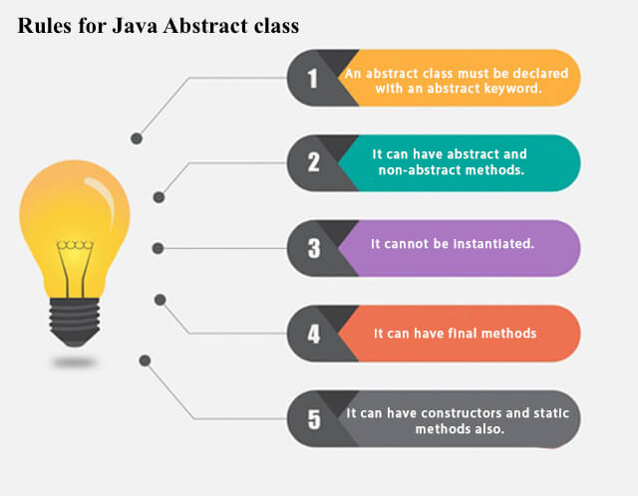
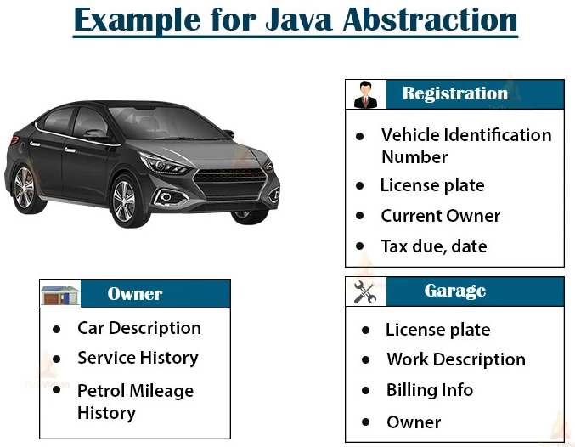
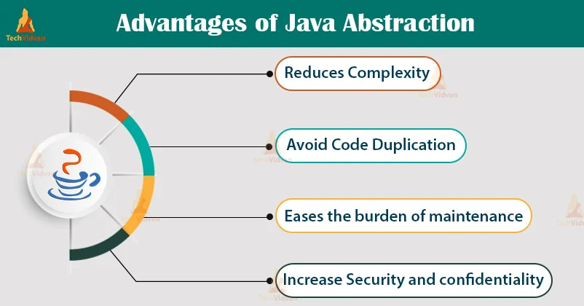
Advantage of Abstraction

Slide 9
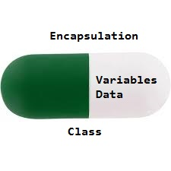
ENCAPSULATION
Encapsulation is a fundamental concept in OOP that refers to the bundling of data and methods that operate on that data within a single unit, which is called a class in Java.
Encapsulation is a way of hiding the implementation details of a class from outside access and only exposing a public interface that can be used to interact with the class.
In Java, encapsulation is achieved by declaring the instance variables of a class as private, which means they can only be accessed within the class.
To allow outside access to the instance variables, public methods called getters and setters are defined, which are used to retrieve and modify the values of the instance variables, respectively.
By using getters and setters, the class can enforce its own data validation rules and ensure that its internal state remains consistent.
By using getters and setters, the class can enforce its own data validation rules and ensure that its internal state remains consistent.

Slide 10
Advantages of Encapsulation in Java:
Improves security of an object’s internal state by hiding it from the outside world.
Increases modularity and maintainability by making it easier to change the implementation without affecting other parts of the code.
Enables data abstraction, allowing objects to be treated as a single unit.
Allows for easy addition of new methods and fields without affecting the existing code.
Supports the object-oriented principle of information hiding, making it easier to change the implementation without affecting the rest of the code.
Disadvantages of Encapsulation in Java:
Can lead to increased complexity, especially if not used properly.
Can make it more difficult to understand how the system works.
May limit the flexibility of the implementation.

